Slide 1

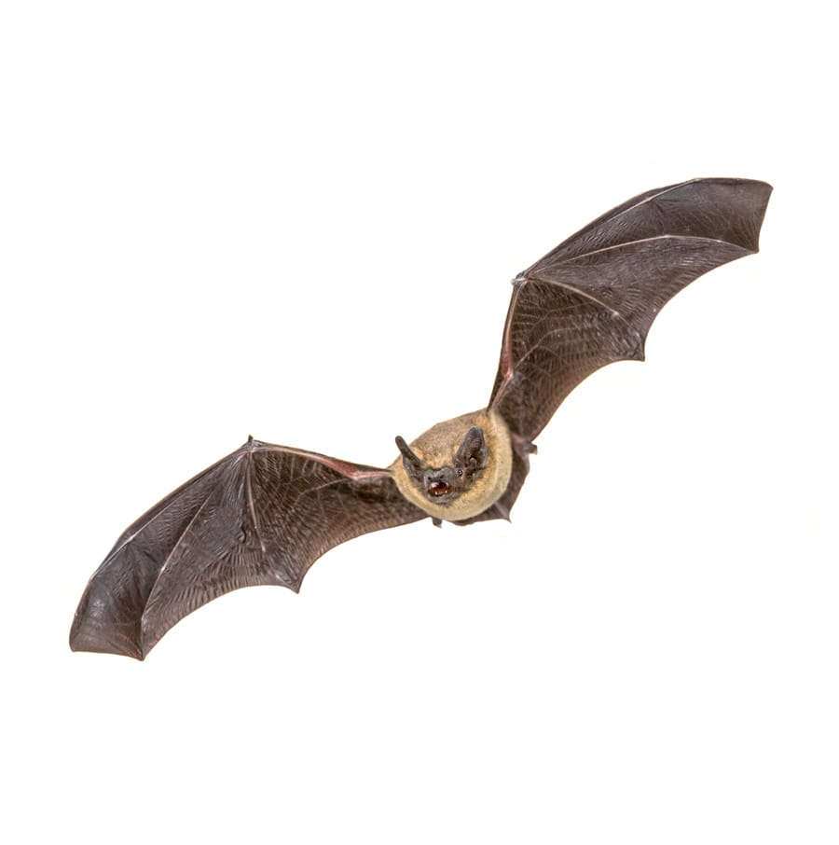
The Future of White Nose Syndrome in North America
Hannah Ashe, Ava Canterino, McKenzie Hagenbuch, Tyler Hills, Megan Walters
(Courtesy of Abbel Pest Control)
Notes:
mckenzie

Slide 2
An Introduction to the Issue
White Nose Syndrome (WNS) is an invasive fungal pathogen affecting hibernating bats
The syndrome proves to be fatal for bats.
Pseudogymnoascus destructans is the fungus which causes WNS.
The North American bat population decline in 2006 catalyzed the eventual, and continuous, loss of an estimated 5 million bats.
Researchers today are working to recover existing bat populations today through the investigation of UVA/UVB and microclimate technology.
WNS proves difficult to manage as humans can act as vectors for fungus transmission, etc; Certain caves in the US have been partially or totally closed to stop the spread.
Notes:
mckenzie

Slide 3
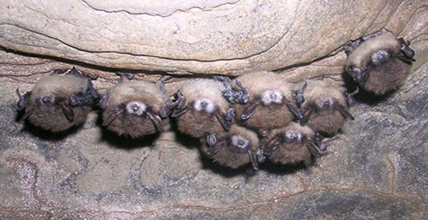
What Is White-Nose Syndrome?
Although present in NY in 2006, WNS was fully recognized as discovered in 2007.
Infected bats experience white fungus growth around the wing epidermis and muzzle area
To save energy during winter hibernation, bats lower their body temperature, creating optimal conditions for WNS to infect and spread onto individuals
Transmission occurs through;
Bat-to-bat physical contact of infected individuals
Bats touching an infected surface within a hibernation cave
Humans spreading the fungus on gear such as shoes or clothes
Today WNS affects most of the United States and 5 Canadian provinces.
NYSDEC/Nancy Heaslip
Notes:
mckenzie

Slide 4
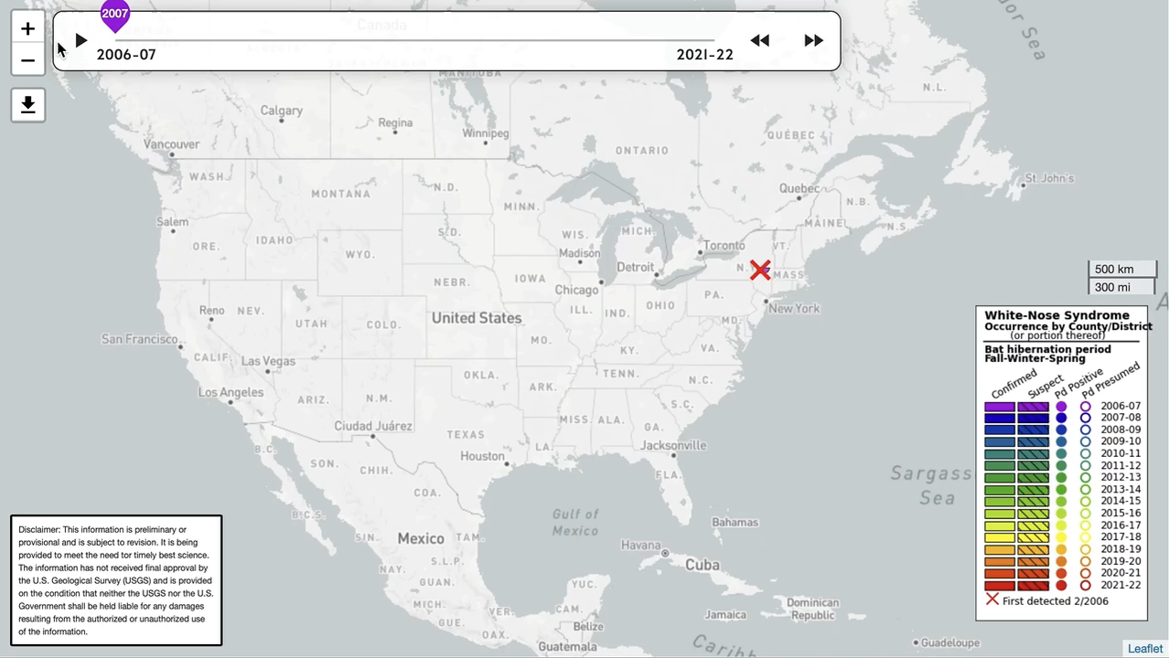
White Nose Response Team, 2022
Notes:
ava

Slide 5
Our Thesis
We believe that due to an increase in public awareness and scientific research on white-nose syndrome, researchers have begun to compile technological efforts within the realm of management with an increased intensity, such as the use of UVA and UVB lights and changing the microclimate of roosting caves to best maximize overall recovery of the affected bat populations.
Notes:
hannah

Slide 6
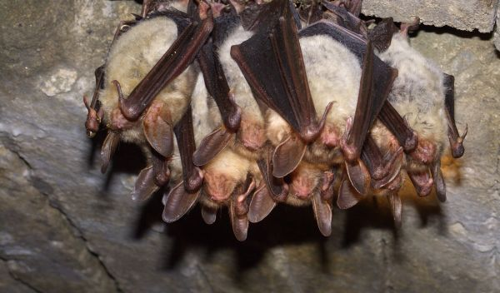
Can bats protect themselves: What leads to higher transmission?
Density Dependent Transmission
Bat Species which exhibit clustering behavior populations decreased regardless of colony size
Solitary species in large colonies were more susceptible than those in small colonies
Microclimates in Hibernacula
Bats in more humid hibernacula had greater decline than those in arid hibernacula
Little Brown Myotis experienced higher decline in hibernacula with higher (3-15 °C) temperatures
NSF/Ivan Horacek
Notes:
tyler

Slide 7
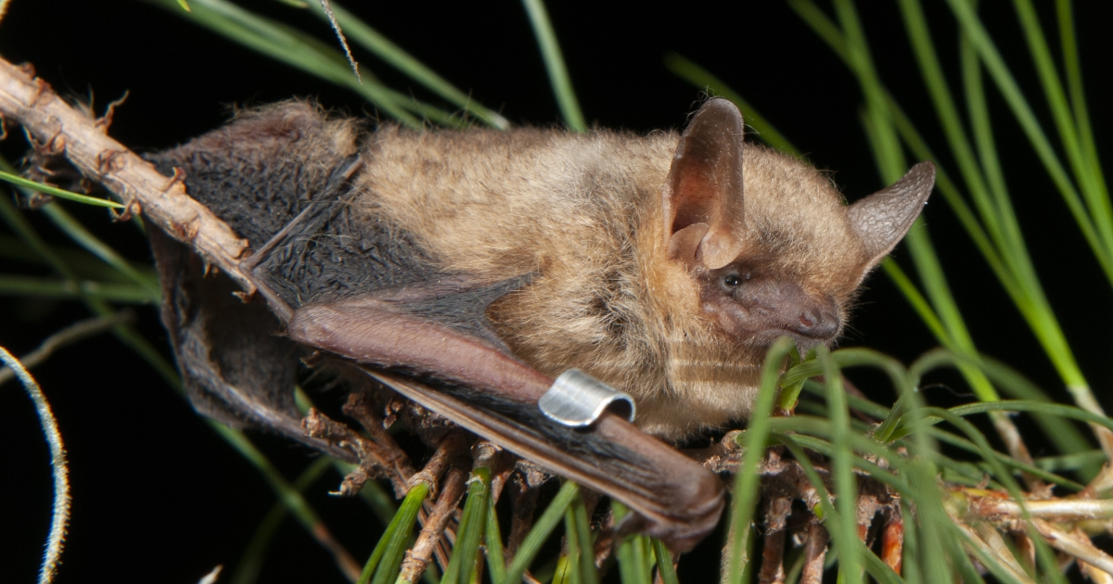
Bat Hibernacula: Could we change it?
Study done by Vanderwolf looked into the idea of changing microclimates within hibernacula to make the conditions less suitable for the spread and growth of WNS
What was found:
Different species of bats react differently to WNS, so if multiple species of bats are hibernating in the same hibernacula than one treatment may not benefit all
Little Brown Myotis had less spread in colder hibernacula
Tri-Colored Bats, once infected with WNS, began hibernating at hibernacula entrances where there was more temperature variation
Controlling certain conditions is out of our reach
How do humans control humidity?
How would we cool massive underground systems?
How could we know how the bats will respond to human intervention?
Tri-Colored Bat
USFWS/ Pete Pattavina
Notes:
megan

Slide 8
Bat Hibernacula: Could we change it?
Another study done by Turner et al. (2021) found that:
Mortality from WNS increased in Little Brown Bats, Big Brown Bats, Small-footed bat, and the Northern Long-Eared bat all increased in colder (3-6 °C) hibernacula
Though WNS is a cold spreading fungus it grows much slower in colder conditions
Little Brown Bats, Big Brown Bats and Small-Footed Bats had higher WNS+ counts in hibernacula with high humidity
Overall, this paper believes that hibernacula manipulation is a positive management tool
When Mike Fishman was interviewed, he cautioned against this management technique due to other cave-dependent flora and fauna and the unknown consequences that cooling would have on them, as well as logistics such as how much would it cost to cool massive subterranean habitats?
Notes:
megan

Slide 9
Use of UVA and UVB Lights to Prevent the Spread of WNS
A 2020 study performed by Colin Hartman looked into the use of ultraviolet A (UVA) and ultraviolet B (UVB) radiation jointly with methoxsalen (a type of photosensitizer) to disable Pseudogymnoascus destructans (the infectious agent of White Nose Syndrome).
Three different treatments were performed
P. destructans was treated with methoxsalen and exposed to UVA
P. destructans was germinated on methoxsalen infused media and then exposed to UVA
Colonies of P. destructans were infused with methoxsalen and then exposed to UVA or UVB
It was found that pre-treatment of the P. destructans with methoxsalen resulted in the inactivation of their spores, depending on the dose of UV radiation
Notes:
hannah

Slide 10
Use of UVA and UVB Lights: How It Works
Methoxsalen inserts itself between the strands of DNA, and when activated by UVA light, it causes covalent cross-linking of the DNA.
This prevents the replication and transcription of DNA, which prevents the P. destructans from reproducing.
If put into practice, the methoxsalen would be added to the bats’ food sources, and the caves would be illuminated with portable UVA or UVB lights to kill the P. destructans spores.
This study shows that the use of a psoralen such as methoxsalen combined with the use of UVA and UVB lights could be a promising method of preventing the spread of WNS.
Notes:
hannah

Slide 11
What is Being Done: Public Involvement
Outreach to the public through agencies suggest what citizens may do to help combat WNS. Some suggestions include:
Adhere to cave closures
Report bat sightings in your area
Plant pollinator garden
Clean shoes and gear before and after entering caves
Report unusual behavior to state national resource agency
Don't disturb the bats
A widely recommended way the public may help is through the building and installation of bat houses.
Notes:
ava

Slide 12
The Future of WNS Management
According to SUNY-ESF Grad Student Julia Rizzo, scientists are using Personal Protective Equipment such as scrubs, gloves, and masks to stop the spread of WNS by researchers.
All PPE that is not disposable is washed before moving onto a new population.
Staging tables are washed between each bat study.
Scrubs are washed each night in 140 ℉ water.
These are all examples of small scale preventative measures that will continue to be used to slow (or stop) the spread.
Because this fungus has spread so rampantly across the US, the most efficient way to manage WNS would be to prevent the spread to currently uninfected populations.
Notes:
mckenzie

Slide 13
Conclusions
Not one of the discussed methods alone can combat WNS
WNS has spread over a large distance and has infected many bats already
Using multiple methods will only be beneficial to assisting bat populations
Both preventing the spread and fighting the fungus directly are both viable and important ways of controlling WNS in bats
WNS is affecting bat populations throughout the United States due to migratory activity along with human interference
Between the scientific studies on WNS and public awareness, the fungus/disease affecting these bats can be controlled and the issue resolved in the future
When will resistance be built?
Though an exact answer is unknown research from the University of Michigan shows that some species of bat are evolving on a genetic level to survive the fungal disease WNS
Notes:
tyler

Slide 14

Any Questions?

Slide 15
Images Cited
https://www.nps.gov/articles/what-is-white-nose-syndrome.htm (Image slide 3)
Horacek, I. 2016. Bats Infected with White Nose Syndrome. National Science Foundation.
Pattavina, P. (n.d.). Tricolored Bat. US. Fish & Wildlife Service.

Slide 16
References
Cheng et al. 2021. The scope and severity of white-nose syndrome on hibernating bats in North America. Conservation Biology 35:1586–1597.
Karen Vanderwolf, and D. McAlpine. 2021, January 20. Hibernacula microclimate and declines in overwintering bats during an outbreak of white‐nose syndrome near the northern range limit of infection in North America - Vanderwolf - 2021 - Ecology and Evolution - Wiley Online Library. https://onlinelibrary.wiley.com/doi/full/10.1002/ece3.7195.
Langwig, K. E., W. F. Frick, J. T. Bried, A. C. Hicks, T. H. Kunz, and A. Marm Kilpatrick. 2012. Sociality, density-dependence and microclimates determine the persistence of populations suffering from a novel fungal disease, white-nose syndrome. Ecology Letters 15:1050–1057.
Turner, G. G., B. J. Sewall, M. R. Scafini, T. M. Lilley, D. Bitz, and J. S. Johnson. 2022. Cooling of bat hibernacula to mitigate white-nose syndrome. Conservation Biology 36:e13803.
Hartman, C. J., J. C. Mester, P. M. Hare, and A. I. Cohen. 2020. Novel inactivation of the causative fungal pathogen of white-nose syndrome with methoxsalen plus ultraviolet A or B radiation. PLoS ONE 15:e0239001–e0239001.
How You Can Help. (n.d.). https://www.whitenosesyndrome.org/static-page/how-you-can-help.
Sandeno, C. 2017, February 12. Research, Public Can Help Bats Survive White-Nose Syndrome. https://www.usda.gov/media/blog/2014/03/25/research-public-can-help-bats-survive-white-nose-syndrome.
First genetic evidence of resistance in some bats to white-nose syndrome, a devastating fungal disease. 2020. . Ecology, Environment &amp; Conservation:341–341. First genetic evidence of resistance in some bats to white-nose syndrome, a devastating fungal disease. - Document - Gale Academic OneFile (oclc.org)

